Slide 1
Event core data
and activities 2022-2023

Slide 2
ALA activities 2022-2023
Extended data project (event core)
API Gateway
Restricted Access Species Data Pathways
Reviewing FINBIF functionality
See https://www.ala.org.au/publications/
Species list tool redevelopment (yet to start)
Australian Reference Genome Atlas (just started)

Slide 3
Event core pipelines - Why ?
Dataset
Better represent systematic survey data
Sampling effort, repeat visits, protocols
Better support species distribution modelling
Current occurrence pipelines are lossy
Parent events not represented
Non-lossy downloads
Survey
SiteVisit
Sample
Occurrence
Measurement
Measurement

Slide 4
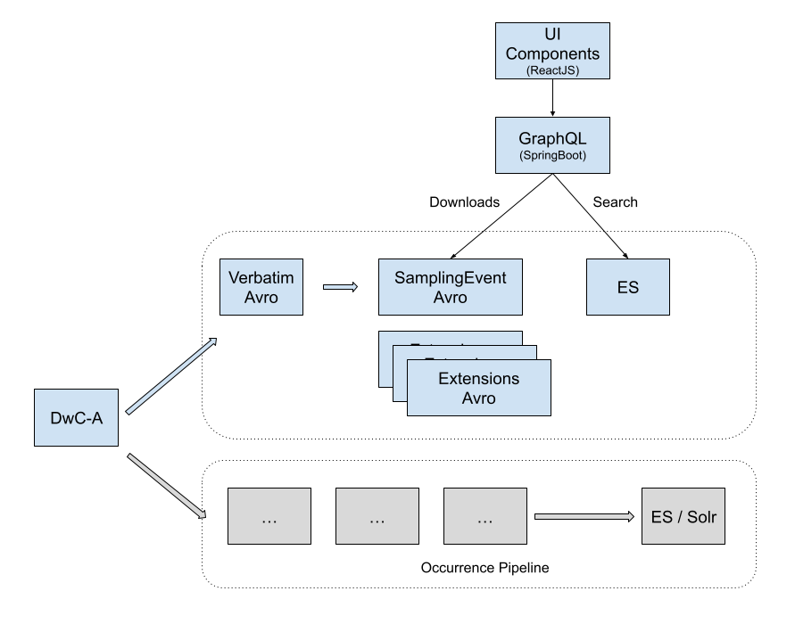
Collaboration with GBIF

Slide 5
Prototype
https://aws-events-test-2022.ala.org.au

Slide 6
Data ingestion
Airflow
(MWAA)
Orchestration
Event core
DwCAs
S3
Pipelines
(EMR)
ElasticSearch
(EC2)

Slide 7
Web architecture
Single page app
(ReactJS)
GraphQL
(Node)
ElasticSearch

Slide 8
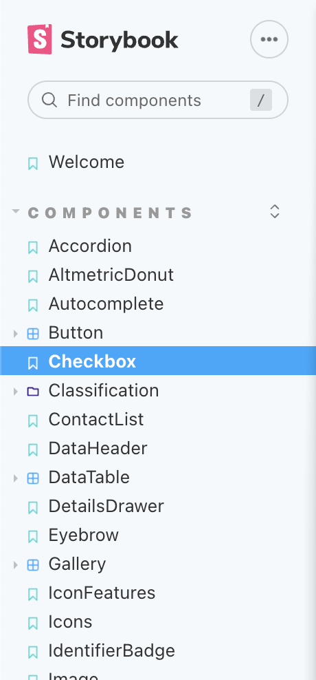
React
JavaScript library for building user interfaces
Maintained by Meta (facebook)
Learning curve
Reusable component library
Storybook
Demo
https://aws-events-test-2022.ala.org.au/react

Slide 9

GraphQL
Data query and manipulation language for APIs
Used by Ecodata
Node JS component
Using GraphQL server
Could be replaced with Spring Boot implementation
https://aws-events-test-2022.ala.org.au/graphql

Slide 10
Elastic search
Nested schema
Join queries
Supporting map vector tiles
https://aws-events-test-2022.ala.org.au/?view=MAP

Slide 11
Summary
Prototype ongoing
Review ReactJS for further use in ALA
Think about overarching GraphQL schema for ALA
Demo: https://aws-events-test-2022.ala.org.au

